Slide 1


Airplane Crash
Analysis
Preeti Priyadarsini
MIP-DA-06

Slide 2

Table of Contents
Introduction | 3
Problem Statement | 4
Dataset Description | 5
Project Objectives | 6
Temporal Analysis Explained | 7
Geospatial Analysis Explained | 9
Operational Analysis Explained | 11
Fatality Trends Explained | 13
Thank You Page | 15

Slide 3
Introduction
This internship project focuses on conducting a comprehensive analysis of airplane crashes and fatalities spanning from 1980 to 2023.
The dataset contains crucial information such as crash dates, locations, operators, flight details, aircraft types, and fatality statistics.

Slide 4
Problem Statement
The goal is to leverage Power BI for interactive visualizations and in-depth insights to understand patterns, contributing factors, and trends in aviation incidents.
The analysis aims to provide stakeholders with valuable information for enhancing aviation safety and mitigating risks.

Slide 5

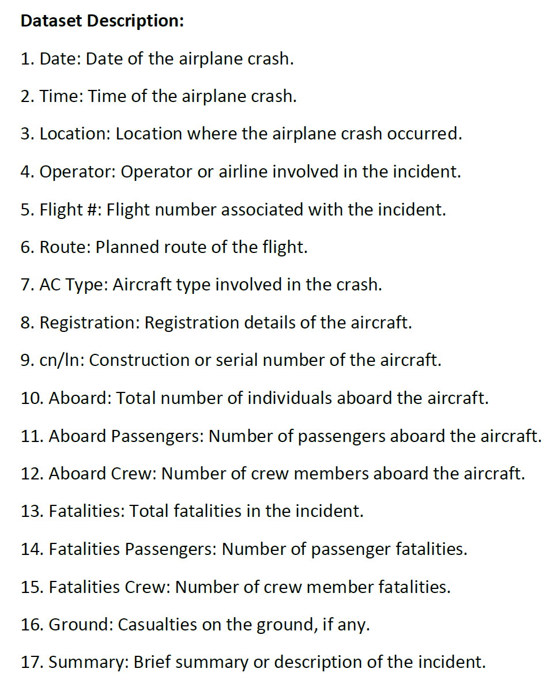

Dataset Description

Slide 6
Project Objectives
TEMPORAL ANALYSIS
Explore temporal trends in airplane crashes over the years.
Identify patterns in the frequency and severity of incidents.
OPERATIONAL ANALYSIS
Evaluate the safety records of different operators and airlines.
Identify operators with higher incident rates.
Visualize crash locations on a map to identify hotspots.
Analyse the distribution of incidents across different regions.
Explore trends in passenger and crew fatalities.
Investigate factors contributing to fatalities.
GEOSPATIAL ANALYSIS
FATALITY TRENDS

Slide 7
Temporal Analysis Explained
Temporal analysis is a method of examining data over time. It allows us to identify trends, patterns, and changes that occur within a specific timeframe. Think of it like watching a movie instead of looking at a single snapshot. In the context of airplane crashes:
Data: We would analyse historical data on airplane crashes, including factors like date, location, type of aircraft, cause of crash, number of fatalities, etc.
Timeframe: The data could span decades, allowing us to see the big picture of how airplane safety has evolved.

Slide 8
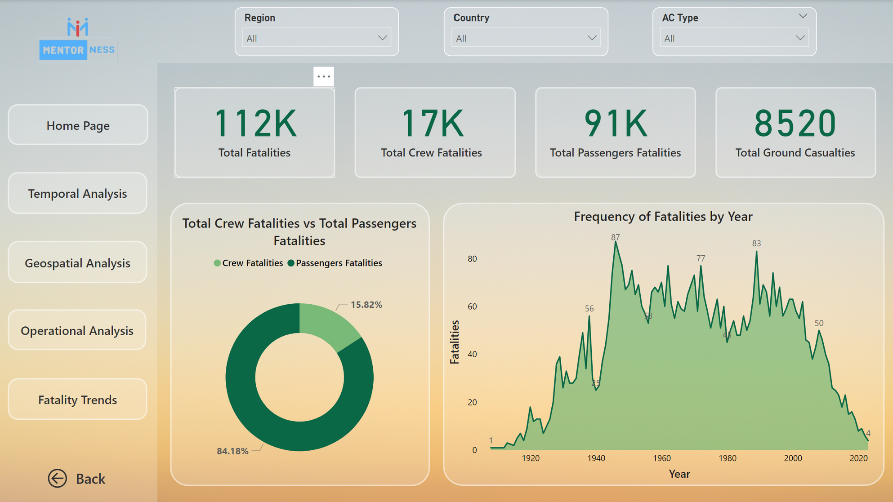

Slide 9
Geospatial Analysis Explained
Geospatial analysis involves studying phenomena using their geographical locations. It's essentially asking "where" things are happening. In the case of airplane crashes, this technique helps us understand the spatial distribution of accidents.
Visualizing Crash Hotspots
Imagine a map of the world with airplane crash locations marked as dots. Geospatial analysis tools can identify areas where these dots cluster more densely. These clusters are called hotspots.
Analyzing Distribution Across Regions
Geospatial analysis goes beyond just hotspots. We can use it to compare the overall distribution of crashes across different regions.

Slide 10
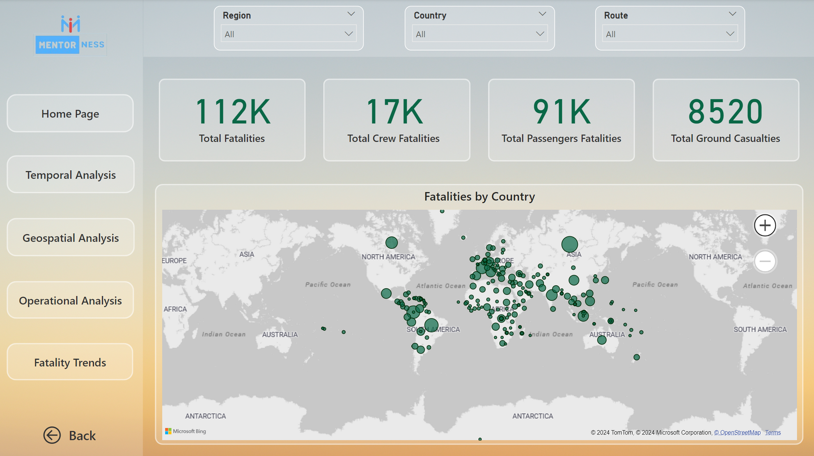

Slide 11
Operational Analysis Explained
Operator Performance is a term used in a couple different contexts related to human interaction with systems. Here's how it can be applied to your interest in airline safety:
Operator Performance in Aviation
In aviation, operator performance refers to the effectiveness of pilots and other personnel involved in operating an aircraft. This includes their:
Situational awareness: Understanding what's happening with the flight, the weather, and potential problems.
Decision-making: Making quick and safe choices in challenging situations.
Communication: Communicating clearly with air traffic control and crew members.
Following procedures: Adhering to established safety protocols.

Slide 12
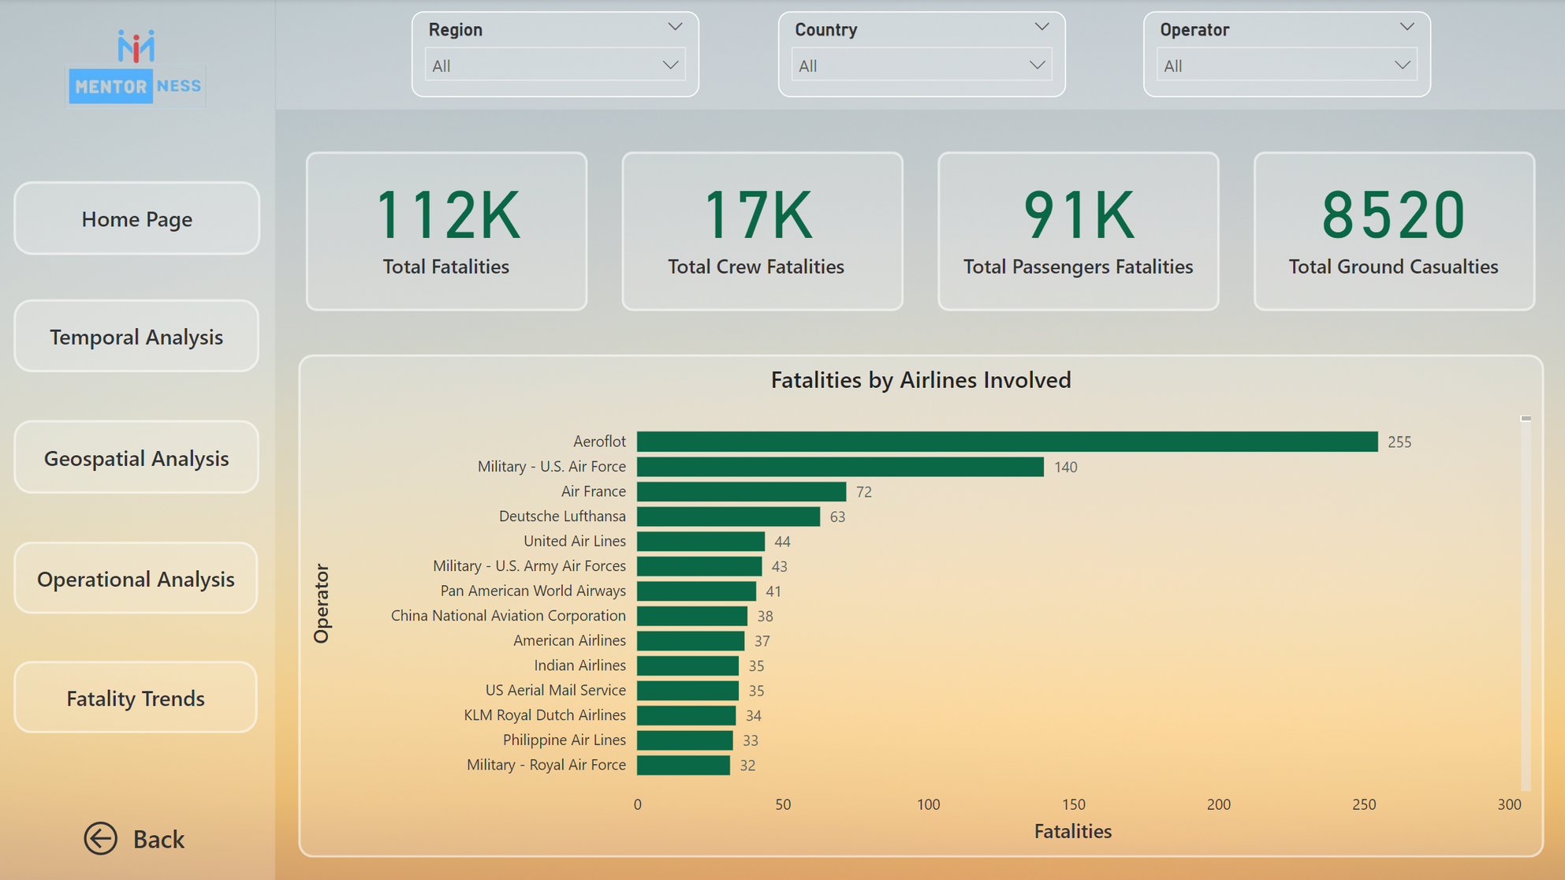

Slide 13
Fatality Trends Explained
Fatality Trends refer to the analysis of patterns and changes in the number of deaths caused by aviation accidents over time.
Exploring Trends:
Overall Fatalities: Look for data on the total number of passenger and crew fatalities in aviation accidents year-over-year.
Investigating Contributing Factors:
Accident Cause Categories: Aviation accidents have various causes. Look for data categorized by factors like human error, mechanical failure, weather conditions, and mid-air collisions.

Slide 14
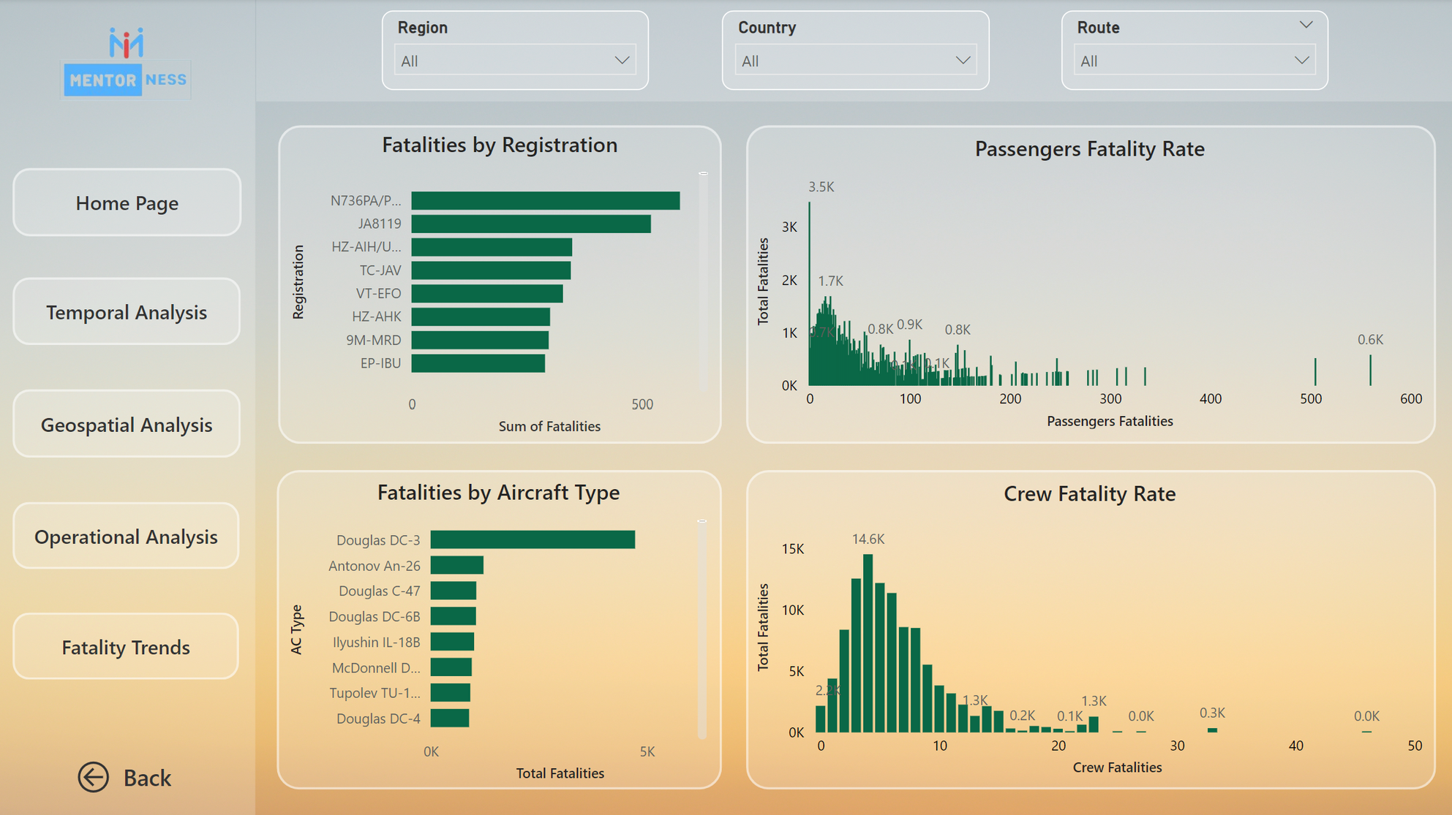

Slide 15
THANK YOU!

